Slide 1
Visualization
Using Power BI

Slide 2
Visualization has been created wrt. To our target variable Win place Prediction.
Types of plot used to show the relation between the input and our target variables are
Line plots
Scatterplots
Key influencer plots
Bar graph

Slide 3
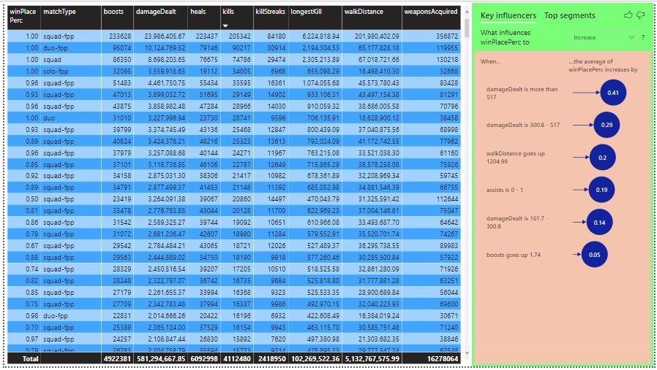

Slide 4
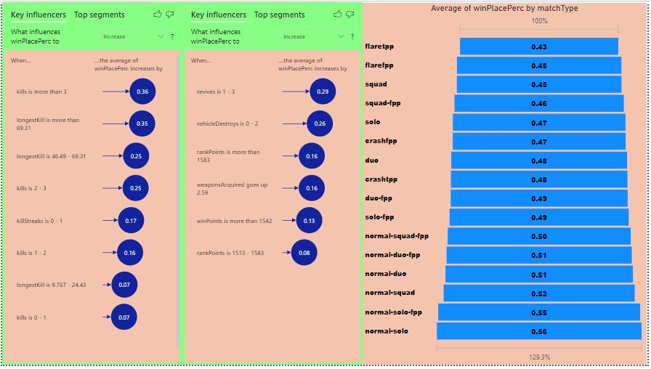

Slide 5
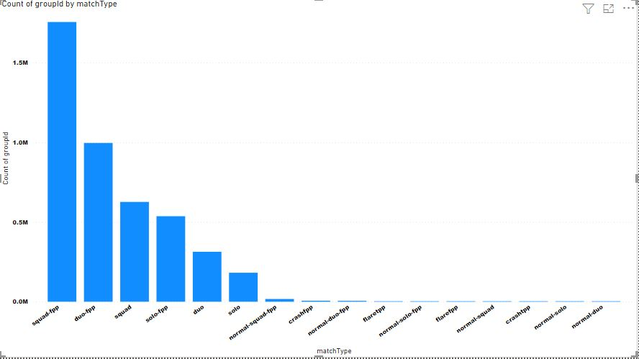

Slide 6
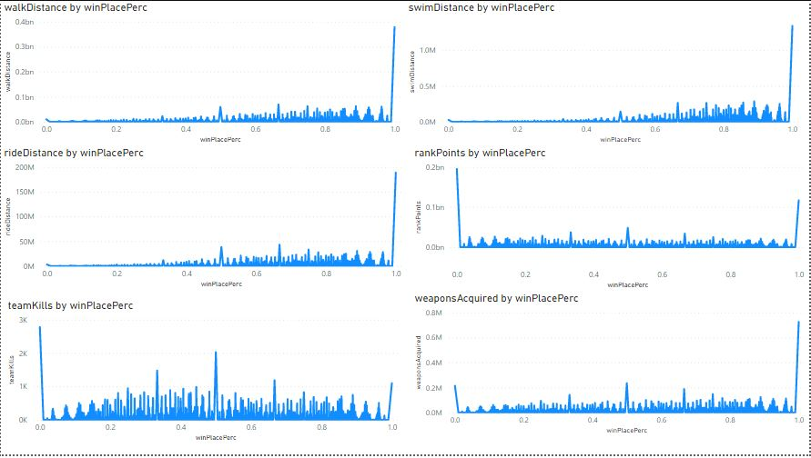

Slide 7
